Slide 1

HERE 4 U
Elizabeth Chrysanta Gunawan (180348)
Ruben Korver (182854)
Class 5

Slide 2
Brand Vision
“In a world where heartbreak tears us apart, we believe that consolation and communication will heal your wounds, because only then you can deal with your broken heart.”

Slide 3


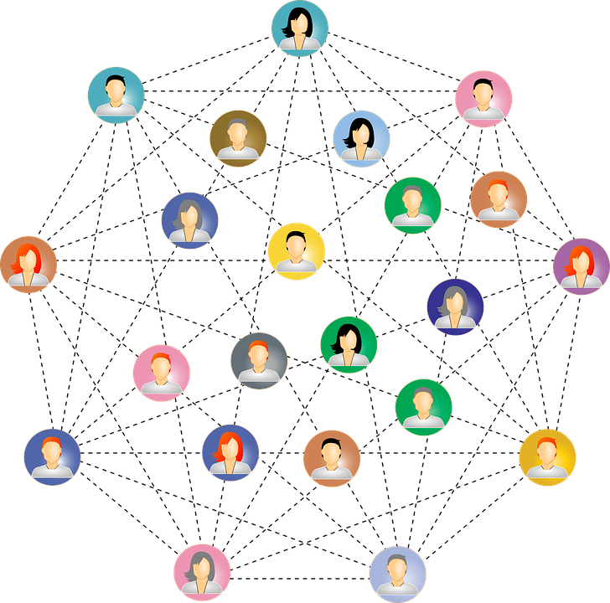

Our Values
Comfort
Safety
Connection
Positive Outlook

Slide 4
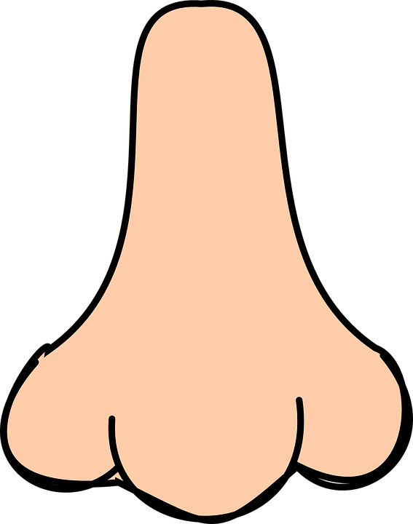




Five Sense
LOOK:
Like the friend, you have not seen in a while.
SMELL:
Like the first day of Autumn.
FEEL:
Like a warm blanket covered around you.
SOUND:
Like a love song you can fall in love with.
TASTE:
Like a bite out of a nostalgic meal, you have not had in awhile.

Slide 5
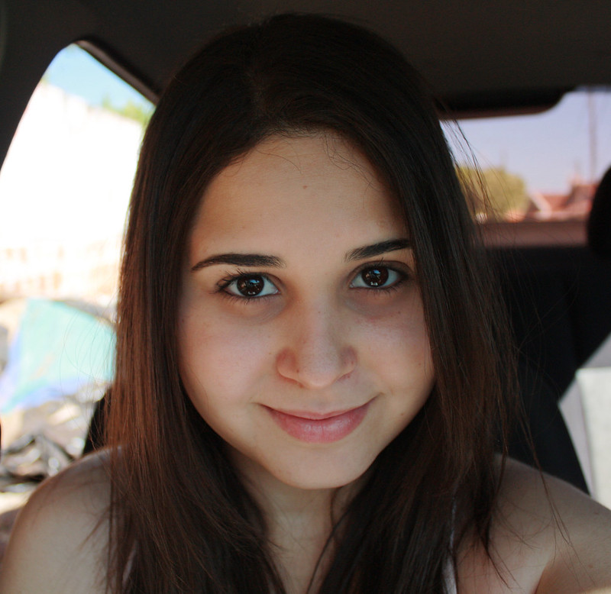
Persona
Name: Laura Akkers Age: 19 Marital status: Single Education: Teacher English 2nd degree Partner preference: Woman
Goals: Wants to seek out a new emotional connection. Wants to finish her study. Wants to start playing a team sport.
Frustrations: hates it when people chew with their mouth open. She hates when people don't reply to a message they have read. See couples being overly affectionate in public.
Bio: Laura Akkers is studying to become an English teacher 2nd Degree. She is in her second year. She has lived on her own for one year now. Her father passed away when she was 3 years old. While she was growing up, she missed a father figure in her life. Her passion lies in helping people, however, after the cruel breakup she had with her girlfriend, she has trust issues and has closed herself off. Currently, she has problems with studying because she feels lost and can't focus.

Slide 6
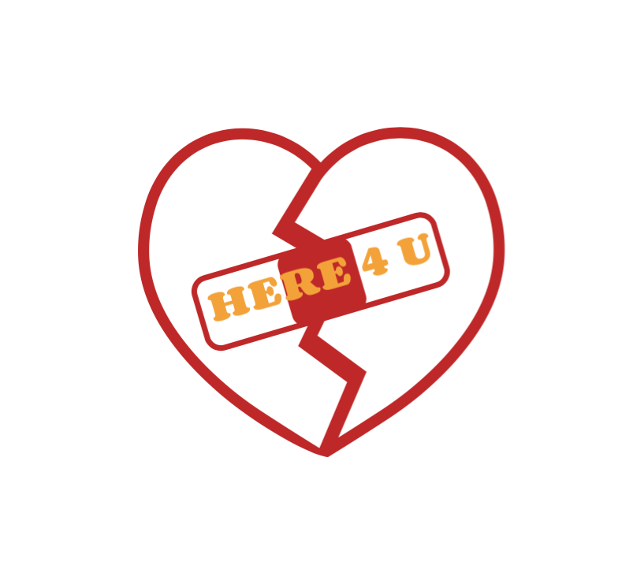
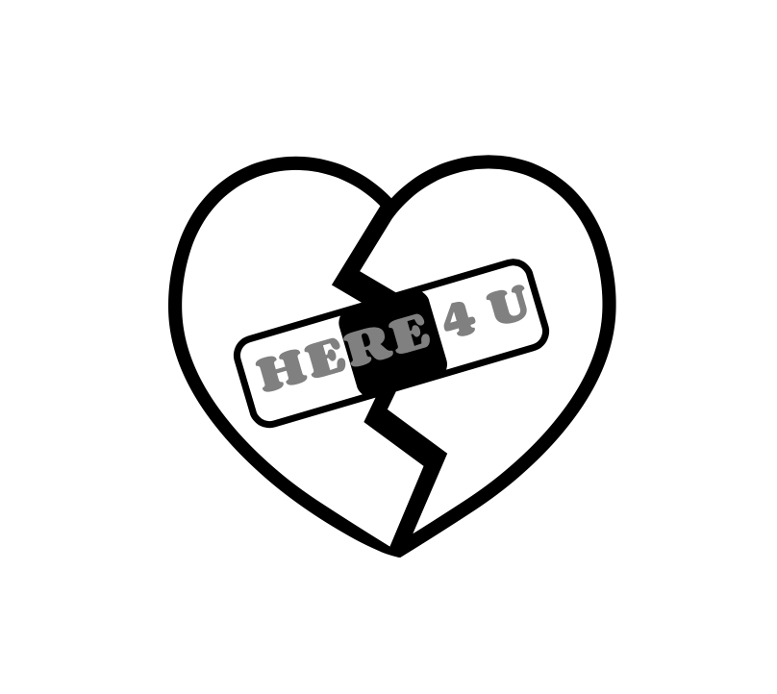

Logo
COLOR:
The two main colors of our brand logo are Red and Orange which is also a representative of autumn colors. Red means passion, desire, and love. On the other hand, Orange represents encouragement and a symbol of strength and endurance.
MEANING:
The logo is an image of a broken heart and a bandage in the middle. If you have a heart break, we will be here for you as a bandage. We will help your wound, not by replacing it to a new one but we want to heal it. The font that we use is Corben 700, it gives a bold look to inform people about our brand.

Slide 7
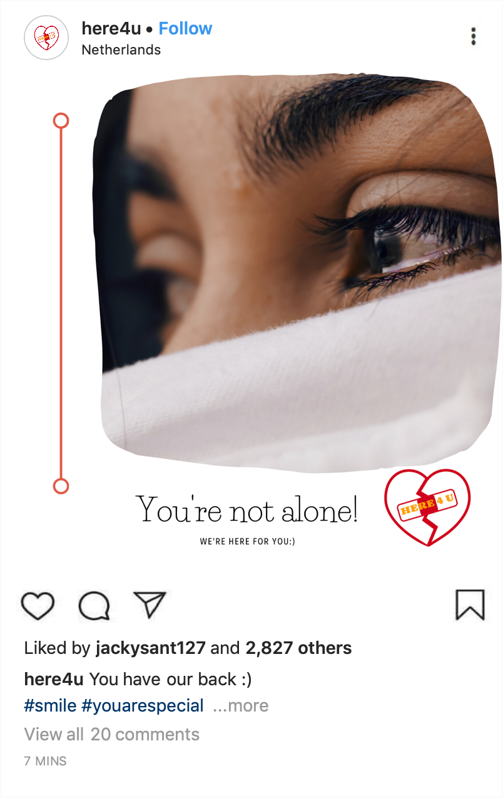
Brand Promotion

